Slide 1
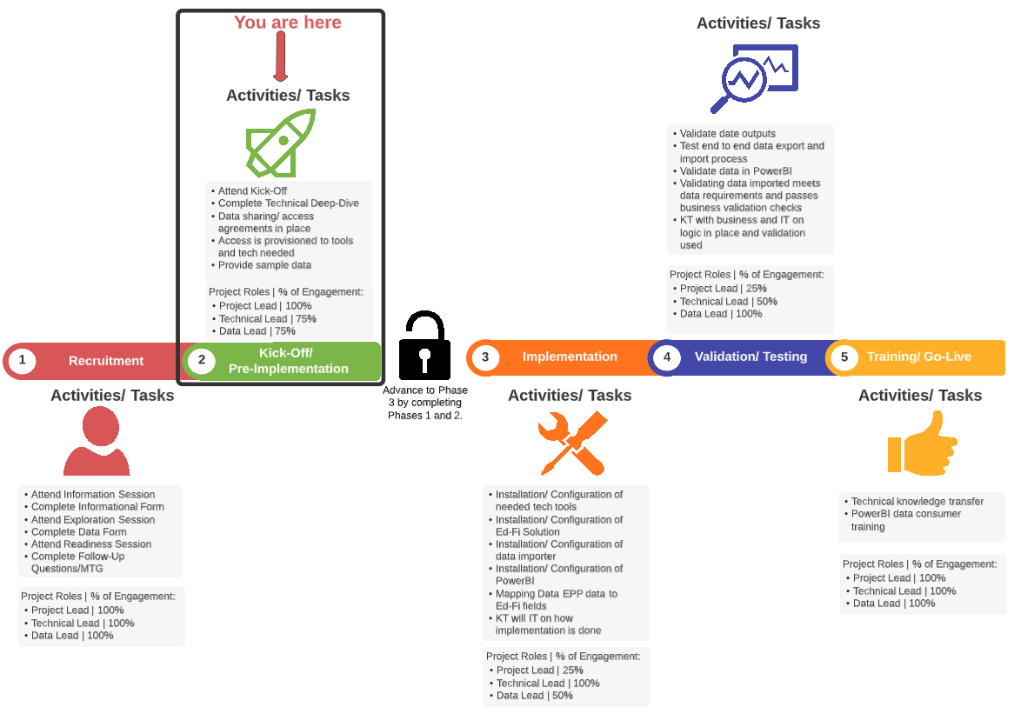
High Level Project Phases

