Slide 1
Data Governance & Data Management
Data Governance Collaborative (DGC)
May, 2017

Slide 2
Introduction
This document is a compilation of resources, white papers, blogs and guides to be used as references for defining a data governance program for the education industry with the focus on effective instruction and student learning. The resources represent a variety of different industry perspectives.
It is a work in progress and additional research, exemplars and lessons learned are to be added by the working members of the Data Governance Collaborative (DGC).

Slide 3
Topics Included
What is Data Governance?
The Need for Data Governance
Why Data Governance?
Data Governance Operating Models and Roles and Responsibilities
Key DG Process, Functions, Rules
Data Governance Collaboration
Data Governance Maturity Levels
Key Initial Steps to Implement Data Governance
Data Privacy and Data Security
Data Governance Tools and Templates
DG Relationship to other Data and Information Concepts
Data Management
Information Management
Process Management
Enterprise Architecture
Data Consumer Concerns
Click the name of the Topic to hyperlink to it.
Click the arrow to return to this page.

Slide 4
What is Data Governance?

Slide 5
What is Data Governance?
Data governance is both a structure and an organizational process.
Data governance establishes the foundation (policies, standards, architecture, decision-making structure, issue-resolution process) for collecting, managing, and releasing data for improved quality, accessibility, and use.
CELT, 2013

Slide 6
What is Data Governance?
Data governance is the means by which an organization makes collective decisions about its information assets. It is both an organizational process and a structure. Data governance establishes responsibility for data, organizing program area staff to collaboratively and continuously improve data quality and use through the systematic creation and enforcement of policies, roles, responsibilities, and procedures.
Bill & Melinda Gates Foundation (2015) Data Systems Working Group Guide to Management Practices

Slide 7
What is Data Governance?
The overall management of the availability, usability, integrity, quality, and security of data. Data governance is both an organizational process and a structure. It establishes responsibility for data, organizing program area/agency staff to collaboratively and continuously improve data quality through the systematic creation and enforcement of policies, roles, responsibilities, and procedures.
The Center for IDEA Early Childhood Data Systems (2016) Who’s in Charge? – Improving How You Manage and Govern Your Data System, Presentation at 2016 Improving Data, Improving Outcomes Conference, New Orleans, LA

Slide 8
The Need for Data Governance

Slide 9
The Need for Data Governance
Typical organizational characteristics of not having clear data governance processes in place:
Ownership of key data elements is often unclear – nobody is accountable for the data.
Departments often purchase their own data systems without adequate coordination with other departments.
The Information Technology Department is viewed as the “owner” of the organization’s data.
Symptoms of not having clear data governance processes:
Data is often stored in multiple locations, including spreadsheets and unsecure desktops or laptops.
There is no identified single source for the “correct data.”
Information is not consistent across the different locations.
Data quality is questionable.
Teachers and administrators are not sure where to go to get the best data for guiding the learning process.
Responding to public inquiries for data is sometimes handled in a disorganized manner.
Data is released to the public that is in error.
State reporting is problematic, with frequent errors.
CELT, Data Governance and Management Presentation, 2013

Slide 10
The Need for Data Governance
For District Leadership:
District leaders will need to have access to a wealth of data and reports to help make instruction, curricular and administrative decisions. The data requirements of student-centered learning necessitate a well-designed data governance strategy to be in place. Often an abundance of data exists, so addressing the questions of what data for what purpose, what audience, and in what format and frequency becomes essential.
iNACOL (2016) Student-Centered Learning: Functional Requirements for Integrated Systems to Optimize Learning

Slide 11
Why Data Governance?

Slide 12
Reason and Purpose
The reason for establishing a strong governance process is to ensure that once data is decoupled from the application that created it, the rules and details of the data are known and respected by all other data constituents. The role governance plays within an overall data strategy is to ensure that data is managed consistently across the company.
The purpose of data governance isn’t to limit data access or insert a harsh, unusable level of rigor that interferes with usage. Its premise is simply to ensure that data becomes easier to access, use and share. The rigor introduced by a data governance effort shouldn’t be overwhelming or burdensome. While data governance may initially affect developers’ productivity (because of the new processes and work activities), the benefits to downstream data constituents and dramatic improvements in productivity should more than counteract the initial impact.
Levy, Evan. The 5 Essential Components of a Data Strategy. Carey, NC: SAS Institute

Slide 13
Benefits
…to help the consumers
Reduce local and global costs of consuming the data
Standard interfaces
High quality data
Service level agreements
Enable consumers to deliver more benefits
New decision support applications
Higher quality decisions
Klein, John. (2017) 6 Things You Need to Know About Data Governance. Pittsburgh, PA: Software Engineering Institute, Carnegie Mellon University

Slide 14
Benefits
Assurance and evidence that data is managed effectively reduces regulatory compliance risk and improves confidence in operational and management decisions
Known individuals, their responsibilities and escalation route reduces the time and effort to resolve data issues
Increased capability to respond to change and events faster through joint understanding across users and IT
Reduced system design and integration effort
Reduced risk of departmental silos and duplication leading to reconciliation effort and argument
Bradley, Christopher. (2013) Implementing Effective Data Governance

Slide 15
Benefits to Education
Increased Effective Use of Data
Data will be more useful when they are aligned with the needs of the program areas. Program offices such as educator effectiveness are positioned to be in more regular communication and collaboration with the key stakeholders such as instructional leadership directors, principals, and teachers who need to use the information in support of the reform initiative. As a result, data users can help define what data they need, when, and in what form.
Bill & Melinda Gates Foundation (2015) Data Systems Working Group Guide to Management Practices

Slide 16
Benefits to Education
Improved Organizational Coordination and Collaboration
All the decisions made as part of data governance are already made in every organization. However, absent data governance, these decisions are made in a fractured, piecemeal way by numerous staff members in isolation from one another. By bringing all the program areas responsible for data together, organization-wide processes are established that reduce the redundancy and inconsistency of effort. Data governance also gives members a means of getting valuable feedback from their colleagues on how to address barriers to data quality and use. Clearly defining the roles and responsibilities of program area staff and IT staff helps reduce the common tensions between these two parts of the organization and establishes a framework for how they work together.
Bill & Melinda Gates Foundation (2015) Data Systems Working Group Guide to Management Practices

Slide 17
Benefits to Education
Higher Quality Data
Data governance provides a venue to regularly identify and address data quality issues. It increases the alignment among program areas by establishing organization-wide definitions, collection processes, and validation procedures. In addition, data governance is a means to identify authoritative data sources for common data and eliminate unnecessary redundancies in collections. Finally, having one person in the organization responsible for a given set of data, regardless of where in the organization it is collected, stored, or reported, helps ensure that the decisions about those data are made more consistently and with an understanding of their purpose within the broader enterprise.
Bill & Melinda Gates Foundation (2015) Data Systems Working Group Guide to Management Practices

Slide 18
Data Governance Benefits to Educational Leadership
Compliance
Responding to public inquiries for data is handled in an organized manner
Data released to the public is accurate and timely
State reporting is no longer problematic with infrequent errors
Organizational Effectiveness
Ownership and accountability of key data elements is clear
Department purchasing is aligned and coordinated with data systems from other departments
Information Technology Department is no longer viewed as the “owner” of the organization’s data
There is an identified single source for the “correct data”
Information is consistent across the organization
Data quality is no longer questionable
Teachers and administrators are clear on where to go to get the best data to guide the learning process

Slide 19
Jeffco Identified Benefits
Additional benefits to building a stronger data governance program for Jeffco include:
Increased cost savings through various means including the reduction of manual manipulation of data and reduction of duplication of data
Reduced risk of potential data privacy breaches because of a better understanding of our data and the rules governing acceptable usage of each data element in our environment
Improved data sharing across departments due to standardization of data formats and definitions, an understanding of data lineage, and a better understanding of acceptable use
Streamlined reporting of data resulting from data standards and better reliability and dependability of the data
Increased confidence in our data, a reduction of the need to validate data, and the enablement of new capabilities because of the increased quality and understanding of our data
Jeffco Public Schools. (2016) Data Governance Operating Model. (draft v0 10). Jefferson County, CO

Slide 20
Data Governance Operating Models

Slide 21
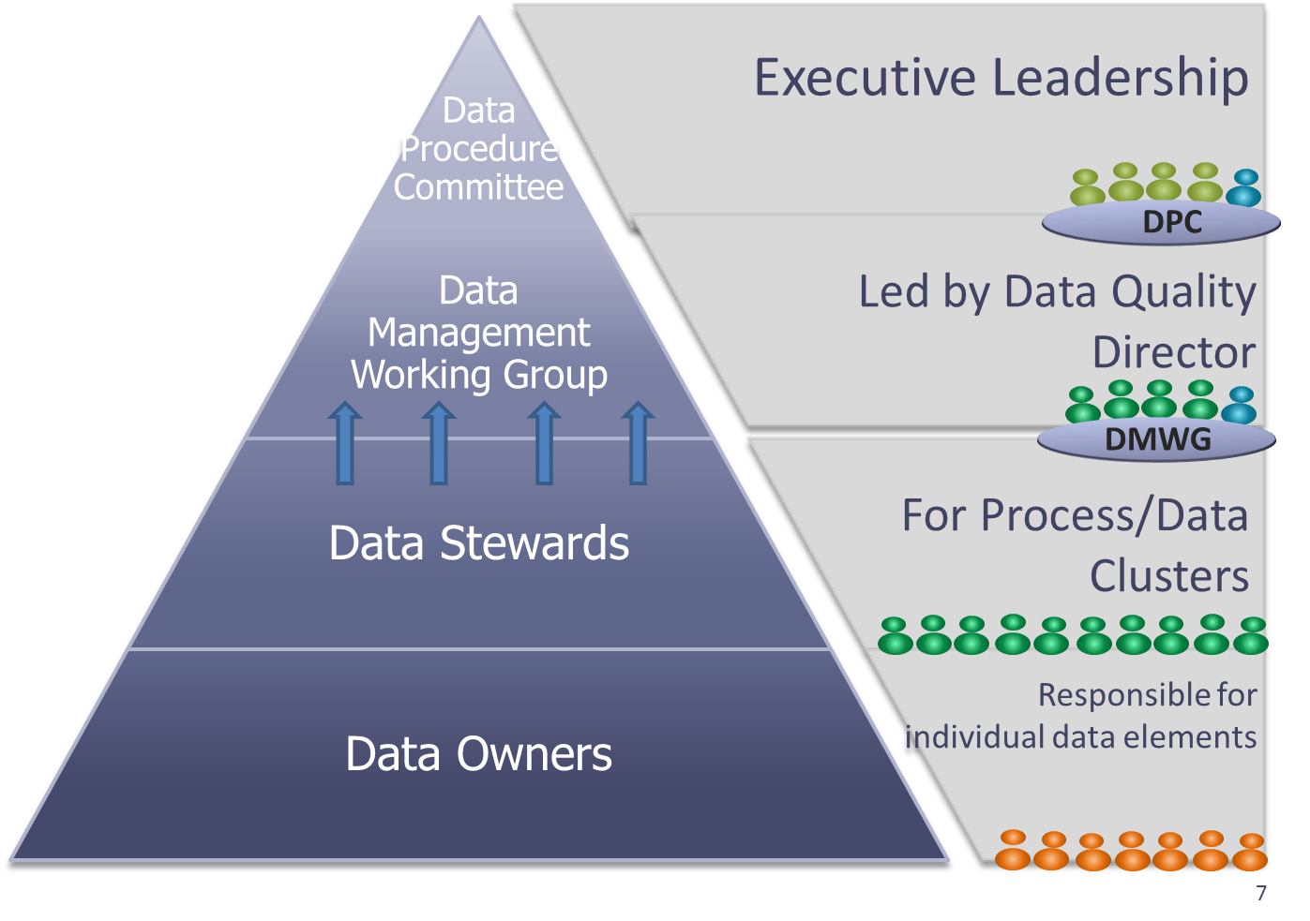
Data Governance Operating Model 1
CELT, 2013

Slide 22
Model 1 Roles and Responsibilities
Data Procedure Committee
Establish data governance directives
Establish Data Management Working Group (DMWG)
Resolve issues escalated by the DMWG
Approve data directives and major data-related decisions proposed by the DMWG
Hold program/process areas accountable for adhering to the data governance directives
Data Management Working Group
Identify, prioritize, and resolve critical data issues affecting the quality, availability, or use of data
Establish and document agency-wide standards, processes, and procedures for data collections, reporting, and release
Data Quality Director
Chair the DMWG
Serve as liaison between DPC and DMWG
Ensure data stewards are fulfilling their responsibilities
Convene working groups of data stewards and data owners to address critical data issues spanning multiple program and process areas

Slide 23
Model 1 Roles and Responsibilities (cont.)
Data Stewards
Participate in monthly DMWG meetings and relevant working groups
Resolve critical data issues within program or process area
Communicate DMWG directives and decisions to program and process area
Data Owners
Determine data definitions, collection frequency, and output requirements for data elements
Communicate with data stewards regarding data element details
Participate in ad-hoc work teams to address data issues

Slide 24
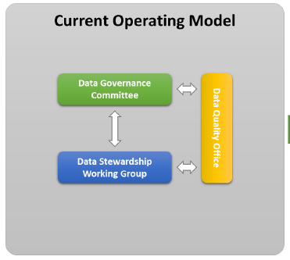
Data Governance Operating Model 2
Jeffco, 2016

Slide 25
Model 2 Roles and Responsibilities
Data Governance Committee
Data Governance Program
District Policies and Procedures
Data Quality Issues
Data Stewardship Working Group
Business Glossary
Role Definition
Prioritization
Data Quality
Policies and Procedures
Data Quality Office
Development and production of scorecards and KPIs measuring data quality
Reporting projects and initiatives progress; management of certain projects and initiatives
Issue tracking and reporting
Ongoing management of the district’s data governance program operations (limited scope – transitions to future Data Governance Office)
Development of district training and awareness programs (limited scope – transitions to future Data Governance Office)

Slide 26
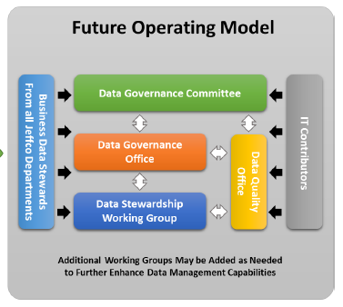
Data Governance Operating Model 3
Jeffco, 2017?

Slide 27
Model 3 Roles and Responsibilities
The future Jeffco operating model will add a Data Governance Office. Responsibilities of this team will include:
Chairs both the Data Governance Committee and the Data Stewardship Working Group
Defining data governance standards and metrics for approval
Managing and tracking data quality issue investigation and resolution
Ensuring adherence to data architecture best practices
Providing communications to the district regarding the data governance program
Ongoing management of the district’s data governance program operations (taking from the current operating model Data Quality Office team and expanding to the full-fledged role)
Development of district training and awareness programs (taking from the current operating model Data Quality Office team and expanding to the full-fledged role)
If needed, a Data Architecture Working Group may also be formed in order to address architectural approach, standards, etc.

Slide 28
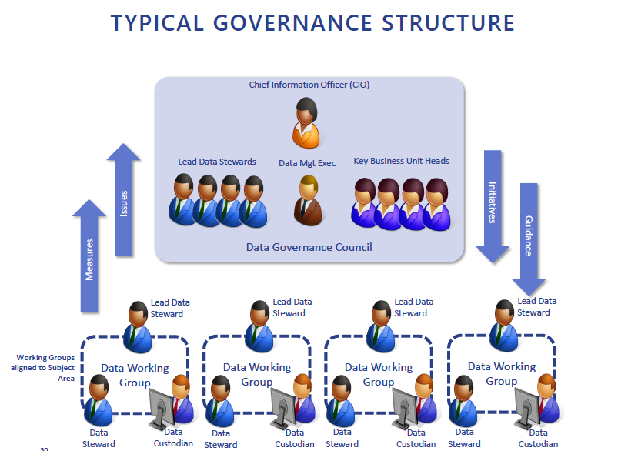
Data Governance Operating Model 4
UK Business Perspective
Bradley, Christopher. (2013) Implementing Effective Data Governance

Slide 29
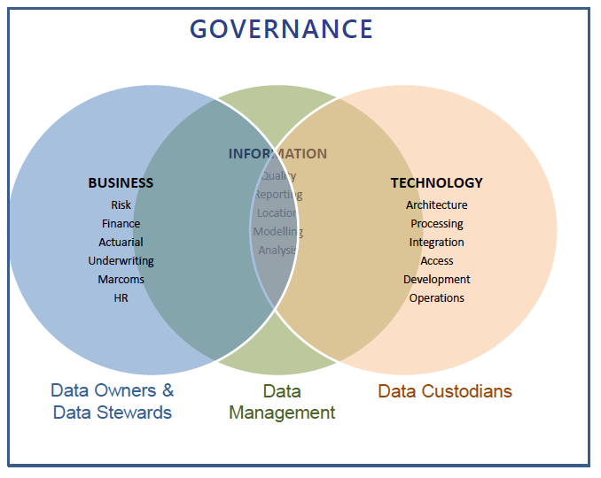
Model 4 Roles and Responsibilities

Slide 30
Data Governance Process, Function, Rules

Slide 31
Key Data Governance Process Components
Assign a Data Quality Director to oversee the process for the District.
Assign a Data Steward for every category of data.
Maintain a standing Data Management Working Group (DMWG) comprised of the Data Stewards of the District.
Proactively address data issues through the DMWG.
Establish and maintain one data dictionary and calendar of data collection/reporting events.
Follow an approval process for data releases designed to ensure accuracy and security.
Create a current-state and desired future-state architecture, and use this to guide decisions and revisions to the District’s data structures.

Slide 32
Data Governance Key Functions
Strategic Planning
Determine enterprise data needs and data strategy
Understand and assess current state data management maturity level
Establish future state data management capability
Establish data professional roles and organizations
Develop and approve data policies, standards, and procedures
Plan and sponsor data management projects and services
Establish data asset value and associated costs
Ongoing Control
Coordinate data governance activities
Manage and resolve data related issues
Monitor and enforce conformance with data policies, standards, and architecture
Communicate and promote the value of data assets
Key Metrics
Data value
Data management cost
Achievement of objectives
Number of decisions made
Steward representation and coverage
Data professional headcount
Data management process maturity
Sun, Helen. (2011) Enterprise Information Management: Best Practices in Data Governance. Redwood Shores, CA: Oracle Corporation

Slide 33
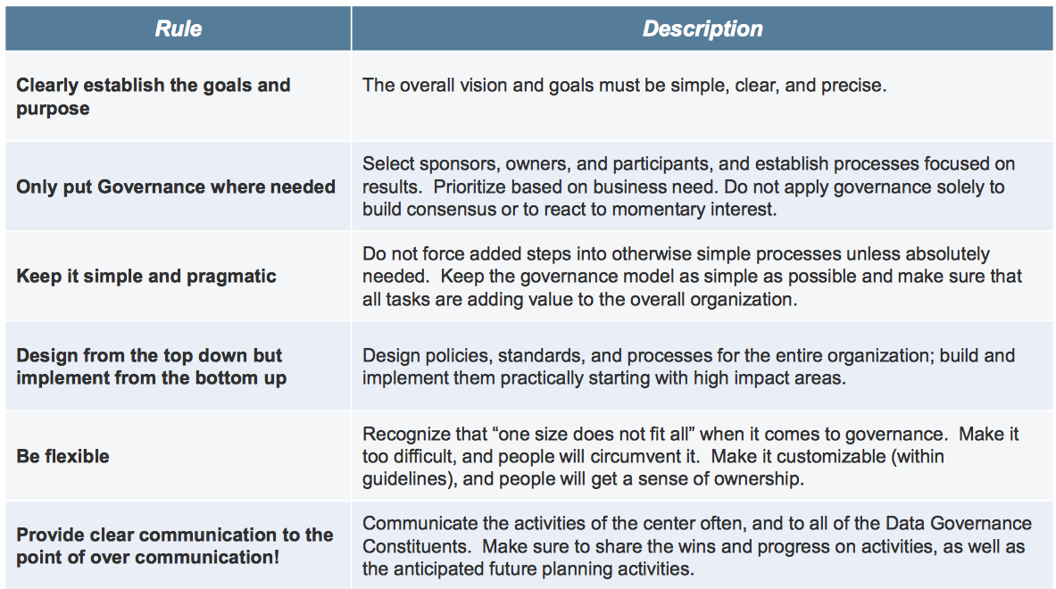
Data Governance – Recommended Rules of the Road
Protiviti (2014) Data Governance Overview, ISACA Atlanta

Slide 34
Data Governance Collaboration

Slide 35
Collaboration Introduction
Because all Data Governance operating models require multiple sets of people in the organization serving various roles, collaboration among the people is key.
The following two slides identify various data governance roles and the need to provide different views into the data based on each role.

Slide 36
Collaboration – The Key to Success
The business data steward is the primary touch point for all data issues in a subject area, and accountable for quality and usage of data within his or her subject area. This person’s responsibility is to:
• Define data quality metrics and thresholds for the subject area.
• Ensure compliance with governance policies and processes within the subject area.
• Identify business metadata to be collected for the subject area.
• Oversee appropriate business use of data in the subject area.
• Create data audit guidelines for data updates and new data sources.
• Work with the data architect to define data relationships.
The data architect defines, models, designs and maintains the data based on business and data requirements. This person’s responsibility is to:
• Define source data extraction standards.
• Provide data modeling expertise.
• Create, maintain and support enforcement of data modeling and naming standards.
• Maintain reference data architecture.
The data quality lead ensures that data conforms to business requirements and maintains the processes and automation necessary for data correction. This person’s responsibility is to:
• Perform root cause and source-data error analysis.
• Perform production data quality monitoring and data remediation.
• Design data quality improvement projects.
• Recommend data quality threshold-level changes.
• Run regular quality inspections of data and create data quality improvement
projects for data not conforming to established standards.
Gidley, Scott., Rausch, Nancy. Best Practices in Enterprise Data Governance. Carey, NC: SAS Institute

Slide 37
Collaboration
The type of information that users in each role create and need to understand to be successful in a data governance initiative
The business data steward wants to define business terminology,
requirements and other details in business terms
A data architect wants to view the information that the business data steward provides to understand and implement the
rules required by the actual data
The data quality lead needs to view both the
business terminology and the rules created by the data architect to be able to know how
to interpret and fix data quality issues when they occur
Gidley, Scott., Rausch, Nancy. Best Practices in Enterprise Data Governance. Carey, NC: SAS Institute

Slide 38
Data Governance Maturity Levels

Slide 39
Data Governance Maturity Levels
In the next 3 slides, each approach to Data Governance Maturity has 5 levels with slightly different nomenclature:
 | Infosys | UK Information Strategist | Oracle
Level 5 | Predictive | Optimized | Optimized
Level 4 | Proactive | Managed | Advanced
Level 3 | Defined | Defined | Standardized
Level 2 | Reactive | Repeatable | Managed
Level 1 | Chaotic | Initial | Initial

Slide 40
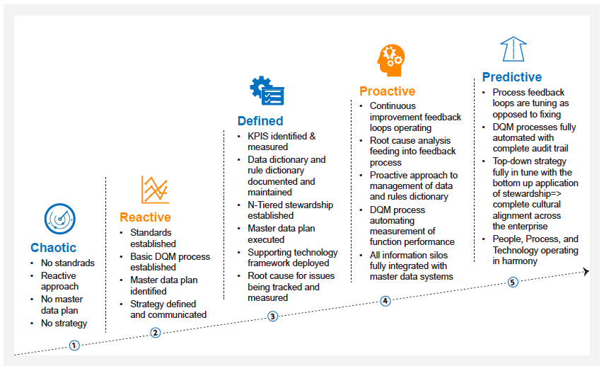
Infosys Data Governance Maturity Phases

Slide 41
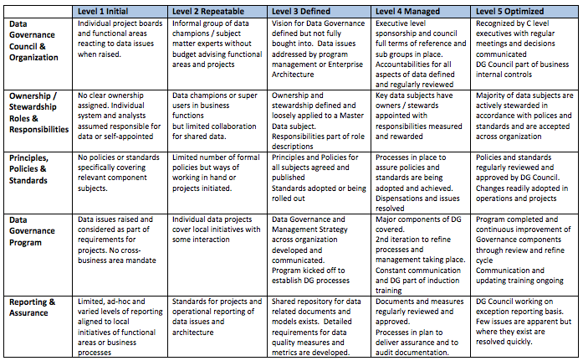
UK Information Strategist’s Data Governance Maturity by Component

Slide 42
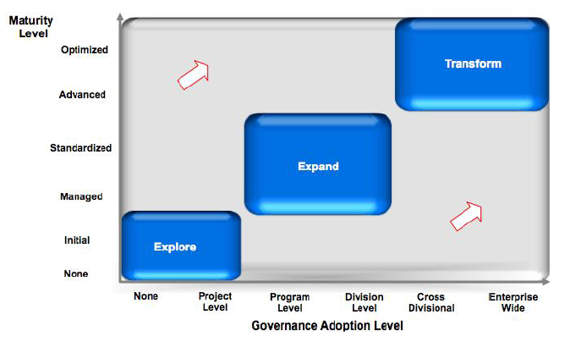
Oracle Data Governance Maturity Model by Adoption

Slide 43
Key Initial Steps to Implement Data Governance

Slide 44
Determine the Purpose and Intended Outcomes of Establishing Data Governance
Data governance requires organizational culture change and changes to how many staff conduct their work. Because of this, it is essential that executive leadership be active supporters of the effort and clearly define the purpose and value proposition to the organization of implementing it. The more closely data governance can be positioned as a support for the goals of the organization, the more likely it is to succeed.
Bill & Melinda Gates Foundation (2015) Data Systems Working Group Guide to Management Practices

Slide 45
Define the Universe of Data Managed by the Data Governance Effort
Clearly delineating the boundaries of the data governance effort helps inform all subsequent decisions, including which program areas need to be represented and by which roles Data governance should (at minimum) encompass all mission-critical data that are used by numerous programs, such as student demographics, enrollment, program participation, and achievement data; school directory information; and educator data. Ideally, data governance should encompass all data collected and used by the organization.
Bill & Melinda Gates Foundation (2015) Data Systems Working Group Guide to Management Practices

Slide 46
Establish a Data Governance Coordinator
A data governance coordinator is essential to direct and manage the work of the data governance groups. This includes ensuring that data governance is implemented in support of the organization’s goals and with clear objectives; that the data governance groups work collaboratively; and that critical data issues are identified, prioritized, and resolved. The role does not have to be full-time, but one person should be responsible for driving the effort forward.
Establish a data governance coordinator
Bill & Melinda Gates Foundation (2015) Data Systems Working Group Guide to Management Practices

Slide 47
Determine Which Programs and Roles Within Them Need to be Represented in the Data Governance Structure
Every program area responsible for data within the above defined scope should be represented in the data governance structure. Most organizations establish two levels of data governance groups (1) executive/policy and(2) implementation. The executive/policy group comprises the executive leadership of the organization. They are responsible for establishing the data governance structure and strategic direction, resolving critical issues that are escalated to them, and ensuring that their staff follow the data governance policies and processes. The implementation-level group comprises the program area data stewards who are responsible for the data in their area and the IT representatives who are responsible for the technology infrastructure that collects, stores, and reports the data. This group does much of the daily work of defining and executing data policies and associated processes for managing data from collection through to reporting. All data governance groups should have documented membership rosters, and data governance responsibilities should become part of the members’ official job duties.
Bill & Melinda Gates Foundation (2015) Data Systems Working Group Guide to Management Practices

Slide 48
Develop a Log of Critical Data Issues that Data Governance will Address
Every organization has more issues than it can address at any given time. Establishing criteria for what constitutes a critical data issue that impedes data quality and use is an important first step toward prioritizing how the data governance groups will focus their attention. Based on these criteria, data stewards identify and take responsibility for resolving critical data issues. Critical data issues that require higher authority to resolve should be escalated to the executive/policy group.
Bill & Melinda Gates Foundation (2015) Data Systems Working Group Guide to Management Practices

Slide 49
Determine the Organization-wide Data Policies and Processes Overseen by Data Governance
Clearly defined, documented, and well-communicated policies and processes let everyone know what needs to happen, by whom, how, and when. Common policies and processes usually overseen by data governance include data access and use, data requests, and data releases. Guided by clear protocols that are consistent within and across program areas, the same core tasks are no longer performed differently by different people. Everyone, including schools, knows what to expect and what is expected of them. Documentation of these processes also helps to ensure sustainability over time despite staff turnover, as well as to increase transparency across the organization.
Bill & Melinda Gates Foundation (2015) Data Systems Working Group Guide to Management Practices

Slide 50
Data Privacy and Data Security

Slide 51
Data Privacy vs. Data Security
Data Privacy:
A privacy program needs to define the processing and protection requirements for personal information. The protection requirements include items such as what organizational roles have access to the information, when and how the information may be shared internally and externally, and when and how the information should be destroyed. These requirements should relate to personal information on any media, not just electronically stored.
Data Security:
These and similar privacy-related requirements are provided to the security program to implement appropriate protections and controls. It is not up to a privacy program to state the technology or processes to be used to protect personal information (though the privacy team may have valuable opinions); it is up to the security specialists to make this determination.
Therefore, a privacy program is dependent upon a security program. This creates a necessity to establish a cooperative, interdependent relationship be established between the teams
Siegel, Bob (2016) What is the difference between privacy and security? IDG CIO Opinion Article

Slide 52
Data Privacy
Successful data management requires a proactive approach to addressing stakeholders’ needs for high-quality data, while protecting the privacy of individual respondents. To accomplish this, organizations are advised to develop and implement a comprehensive data governance program. A sound governance program will help organizations to improve their decision making and improve efficiency of operations through establishing a coordinated response to common issues, such as data access controls and staff training; standardizing data definitions and processes; and implementing a holistic approach to mitigating data security risks.
Some definitions:
Personally identifiable information (PII) refers to information that can be used to distinguish or trace an individual’s identity either directly or indirectly through linkages with other information. Additional information on PII is available in the Family Educational Rights and Privacy Act regulations, 34 CFR §99.3.
Sensitive data are data that carry the risk for adverse effects from an unauthorized or inadvertent disclosure. This includes any negative or unwanted effects experienced by an individual whose personally identifiable information (PII) was the subject of a loss of confidentiality that may be socially, physically, or financially damaging, as well as any adverse effects experienced by the organization that maintains the PII.
Privacy Technical Assistance Center (2014): Data Governance and Stewardship

Slide 53
Privacy Information and Fair Information Practices
Collection Limitation—There should be limits to the collection of personal data and any such data should be obtained by lawful and fair means and, where appropriate, with the knowledge or consent of the data subject.
Data Quality—Personal data should be relevant to the purposes for which they are to be used, and, to the extent necessary for those purposes, should be accurate, complete and kept up-to-date.
Purpose Specification—The purposes for which personal data are collected should be specified not later than at the time of data collection and the subsequent use limited to the fulfillment of those purposes or such others as are not incompatible with those purposes and as are specified on each occasion of change of purpose.
Use Limitation—Personal data should not be disclosed, made available or otherwise used for purposes other than those specified, except with the consent of the data subject or by the authority of law.
Security Safeguards—Personal data should be protected by reasonable security safeguards against such risks as loss or unauthorized access, destruction, use, modification or disclosure of data.
Guide to Protecting the Confidentiality of Personally Identifiable Information (PII)
Recommendations of the National Institute of Standards and Technology

Slide 54
Privacy Information and Fair Information Practices
Openness—There should be a general policy of openness about developments, practices and policies with respect to personal data. Means should be readily available of establishing the existence and nature of personal data, and the main purposes of their use, as well as the identity and usual residence of the data controller.
Individual Participation—An individual should have the right: (a) to obtain from a data controller, or otherwise, confirmation of whether or not the data controller has data relating to him; (b) to have communicated to him, data relating to him within a reasonable time; at a charge, if any, that is not excessive; in a reasonable manner; and in a form that is readily intelligible to him; (c) to be given reasons if a request made under subparagraphs (a) and (b) is denied, and to be able to challenge such denial; and (d) to challenge data relating to him and, if the challenge is successful, to have the data erased, rectified, completed, or amended.
Accountability—A data controller should be accountable for complying with measures which give effect to the principles stated above.
Guide to Protecting the Confidentiality of Personally Identifiable Information (PII)
Recommendations of the National Institute of Standards and Technology

Slide 55
Student Data Principles
In fall 2014, the Data Quality Campaign and the Consortium for School Networking convened a diverse coalition of national education organizations to talk about what was needed to do together to address important and pressing concerns about student data privacy, and equip the field with the ability to effectively use and protect student information.
Together they developed the Student Data Principles. These 10 principles are the values that guide the work of everyone who uses student information to support learning and success. This is a fundamental framework for educational institutions to build upon, above and beyond complying with federal, state, and local laws
CoSN (2014) 10 Principles to Guide the User and Protection of Student Data, website

Slide 56
Student Data Principles
Student data should be used to further and support student learning and success.
Student data are most powerful when used for continuous improvement and personalizing student learning.
Student data should be used as a tool for informing, engaging, and empowering students, families, teachers, and school system leaders.
Students, families, and educators should have timely access to information collected about the student.
5 Student data should be used to inform and not replace the professional judgment of educators.
Students’ personal information should only be shared, under terms or agreement, with service providers for legitimate educational purposes; otherwise the consent to share must be given by a parent, guardian, or a student, if that student is over 18. School systems should have policies for overseeing this process, which include support and guidance for teachers.
Educational institutions, and their contracted service providers with access to student data, including researchers, should have clear, publicly available rules and guidelines for how they collect, use, safeguard, and destroy those data.
CoSN (2014) 10 Principles to Guide the User and Protection of Student Data, website

Slide 57
Student Data Principles
Educators and their contracted service providers should only have access to the minimum student data required to support student success.
Everyone who has access to students’ personal information should be trained and know how to effectively and ethically use, protect, and secure it.
Any educational institution with the authority to collect and maintain student personal information should
have a system of governance that designates rules, procedures, and the individual or group responsible for decision making regarding data collection, use, access, sharing, and security, and use of online educational programs;
have a policy for notification of any misuse or breach of information and available remedies;
maintain a security process that follows widely accepted industry best practices;
provide a designated place or contact where students and families can go to learn of their rights and have their questions about student data collection, use, and security answered.
CoSN (2014) 10 Principles to Guide the User and Protection of Student Data, website

Slide 58
Data Security
Establishing a comprehensive data governance program will help to ensure confidentiality, integrity, and availability of the data by reducing data security risks due to unauthorized access or misuse of data

Slide 59
Data Security Lessons Learned
Start with security.
Control access to data sensibly.
Require secure passwords and authentication.
Store sensitive personal information securely and protect it during transmission.
Segment your network and monitor who’s trying to get in and out.
Secure remote access to your network.
Apply sound security practices when developing new products.
Make sure your service providers implement reasonable security measures.
Put procedures in place to keep your security current and address vulnerabilities that may arise.
Secure paper, physical media, and devices.
Federal Trade Commission (xxx) Start with Security: A Guide for Business

Slide 60
Top Threats to Data Protection
The U.S. Department of Education’s Privacy Technical Assistance Center has provided a list of security threats and offer mitigation measures for each threat:
Technical Data Security Threats | Non-technical Data Security Threats
Non-existent Security Architecture | Insider
Un-patched Client Side Software Applications | Poor Passwords
“Phishing” and Targeted Attacks | Physical Security
Internet Web sites | Insufficient Backup and Recovery
Poor Configuration Management | Improper Destruction
Mobile Devices | Social Media
Cloud Computing | Social Engineering
Removable Media
Botnets
Zero-day Attacks
Privacy Technical Assistance Center (2011): Data Security: Top Threats to Data Protection

Slide 61
Data Governance Tools and Templates

Slide 62
PTAC Data Governance Checklist
The Privacy Technical Assistance Center (PTAC) has created a checklist to assist organizations with establishing and maintaining a successful data governance program to help ensure the individual privacy and confidentiality of education records.
The checklist includes the following topics:
Decision-making authority
Standard policies and procedures
Data inventories
Data content management
Data records management
Data quality
Data access
Data security and risk management
Privacy Technical Assistance Center (2015): Data Governance Checklist

Slide 63
Data Governance Policy
A Data Governance Policy formally outlines how business activity monitoring should be carried out to ensure organizational data is accurate, accessible, consistent and protected. The policy establishes who is responsible for information under various circumstances and specifies what procedures should be used to manage it.
A data governance policy is a living document, which means it is flexible and can be quickly changed in response to changing needs. An effective data governance policy requires a cross-discipline approach to information management and input from executive leadership, business process owners, subject matter experts, information technology (IT) and other data stewards within the organization.
Samples include:
Data Governance System for K-12 Data, Policies and Procedures, State of Washington, Office of Superintendent of Public Instruction, 2015 (See References for link) available at http://www.k12.wa.us/K12DataGovernance/pubdocs/DataGovernanceManual.pdf
See: Sample Data Governance and Management Policy (See Appendix A)

Slide 64
Data Steward Identification List
A Data Steward Identification List can be used at the outset of establishing a data governance process and appended to the Data Governance and Management Policy.
See: Sample Data Steward Identification List (See Appendix B)

Slide 65
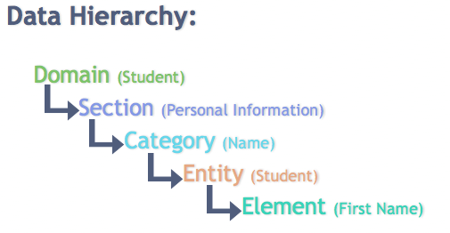
Data Hierarchy
Prior to developing a data dictionary, the structure of the data in the dictionary should be determined. Below is a sample.

Slide 66
Data Dictionary
A Data Dictionary a set of information describing the contents, format, and structure of a database and the relationship between its elements, used to control access to and manipulation of the database.
The Data Dictionary conforms to the established data hierarchy and identifies information about each data element including definition, source system, business use, and technical metadata regarding the element.
See: Sample Data Dictionary Template (See Appendix C)

Slide 67
Data Resolution Process

Slide 68
Data Governance and other Data and Information Concepts
Data Governance’s relationship to Data Management, Information Management, Process Management, and Enterprise Architecture

Slide 69
Data Management

Slide 70
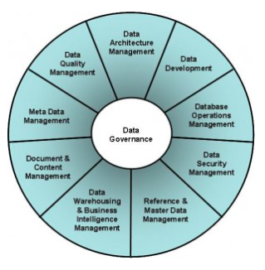
Data Governance vs. Data Management
The DAMA✻ Dictionary of Data Management defines Data Governance as:
“The exercise of authority, control and shared decision making (planning, monitoring and enforcement) over the management of data assets.”
DAMA has identified 10 major functions of Data Management in the DAMA-DMBOK (Data Management Body of Knowledge). Data Governance is identified as the core component of Data Management, tying together the other 9 disciplines, such as Data Architecture Management, Data Quality Management, Reference & Master Data Management, etc.
✻ The Data Management Association (DAMA International) is the Premiere organization for data professionals worldwide. DAMA International is an international not-for-profit membership organization. Its purpose is to promote the understanding, development, and practice of managing data and information to support business strategies.
Harper, Jelani. (2015) Distinguishing Data Management from Data Governance. DataVersity Blog

Slide 71
Data Governance vs. Data Management
A more in-depth model of of Data Management …

Slide 72
Data Governance vs. Data Management
Governance is part of the overall management of data. Specifically, Data Management consists of several different realms; one of the most notable is Data Governance. This viewpoint is substantiated by the Data Management Maturity (DMM) model formulated by the Capability Maturity Model Integration (CMMI) Institute.
Adding to the confusion is the fact that for every reference to Data Management and Data Governance, there is seemingly another for Information Management and Information Governance. There are also varying subsets of these terms such as Enterprise Information Management, Master Data Management, Metadata Management, Lifecycle Management, and myriad others.
Harper, Jelani. (2015) Distinguishing Data Management from Data Governance. DataVersity Blog

Slide 73
Data Management Backgrounder: Data Quality
What is it?
Data quality is the practice of making sure data is accurate and usable for its intended purpose. Just like ISO 9000 quality management in manufacturing, data quality should be leveraged at every step of a data management process. This starts from the moment data is accessed, through various integration points with other data, and even includes the point before it is published, reported on or referenced at another destination.
Why is it important?
It is quite easy to store data, but what is the value of that data if it is incorrect or unusable? A simple example is a le with the text “123 MAIN ST Anytown, AZ 12345” in it. Any computer can store this information and provide it to a user, but without help, it can’t determine that this record is an address, which part of the address is the state, or whether mail sent to the address will even get there. Correcting a simple, single record manually is easy, but just try to perform this process for hundreds, thousands or even millions of records! It’s much faster to use a data quality solution that can standardize, parse and verify in an automated, consistent way. By doing so at every step, risks like sending mail to a customer’s incorrect address can be eliminated
Data Management Backgrounder: What it is – and why it matters (SAS Institute 2015)

Slide 74
Data Management Backgrounder: Data Integration
What is it?
Once you have accessed the data, what do you do with it? A pretty common next step is to combine it with other data to present the unified results. Data integration is the process that defines the steps to do this, and data integration tools help you design and automate the steps that do this work. The most common types of data integration tools are known as ETL, which stands for extract, transform and load, and ELT, which stands for extract, load and transform. Today, data integration isn’t limited to movements between databases. With the availability of in-memory servers, you might be loading data straight into memory, which bypasses the traditional database altogether.
Why is it important?
Data integration is what allows organizations to create blended combinations of data that are ultimately more useful for making decisions. For example, one set of data might include a list of all customer names and their addresses. Another set of data might be a list of online activity and the customer names. By itself, each set of data is relevant and can tell you something important. But when you integrate elements of both data sets, you can start to answer questions like, “Who are my best customers?” “What is the next best offer?” Combining some key information from each set of data would allow you to create the best customer experience.
Data Management Backgrounder: What it is – and why it matters (SAS Institute 2015)

Slide 75
Data Management Backgrounder: Data Federation
What is it?
Data federation is a special kind of data integration. The ETL and ELT types of data integration combine data and then store it elsewhere for use, in the past within a data mart or data warehouse. But what if you simply want to look at
the combined results without the need to move and store it beforehand? Data federation provides the capacity to do just that, allowing you to access the combined data at the time it is requested.
Why is it important?
While many ETL and ELT data integration tools can run very fast, their results can only ever represent a snapshot of what happened at a certain point in time when the process ran. With data federation, a result is generated based on what the sources of data look like at the time the result is requested. This allows for a timelier and potentially more accurate view of information. Imagine you’re buying a gift for your loved one at the store. As you check out, you receive an offer for another item that complements the gift you’ve chosen and happens to be something your loved one would enjoy. Even better – the item is in stock in the same store. Thanks to real-time analysis of next-best offer data and location data, the retailer enhances your shopping experience by delivering a convenient, relevant offer to you at the right time and the right place.
Data Management Backgrounder: What it is – and why it matters (SAS Institute 2015)

Slide 76
Data Management Backgrounder: Data Governance
What is it?
Data governance is the exercise of decision-making authority over the processes that manage your organization’s data. Or to put it another way, it’s making sure that your data strategy is aligned to your business strategy.
Why is it important?
Data governance starts by asking general business questions and developing policies around the answers: How does your organization use its data? What are the constraints you have to work within? What is the regulatory environment? Who has responsibility over the data? Once the answers to these questions are known, rules that enforce them can be defined. Examples of such rules might be defining what data users can access, defining which users can change the data versus simply view it, and defining how exceptions to rules are handled. Data governance tools can then be used to control and manage the rules, trace how they are handled, and deliver reports for audit purposes.
The auditability aspect of this is perhaps the most vital, as the organization’s leaders have to sign o on the accuracy of financial reports to governance boards, shareholders, customers and governmental bodies. It’s a heavy responsibility and one that carries the risk of censure, heavy fines and even legal action if not handled correctly.
Data Management Backgrounder: What it is – and why it matters (SAS Institute 2015)

Slide 77
Data Management Backgrounder: Master Data Management
What is it?
Master data management (MDM) is a set of processes and technologies that defines, unifies and manages all of the data that is common and essential to all areas of an organization. This master data is typically managed from a single location, often called a master data management hub. The hub acts as a common access point for publishing and sharing this critical data throughout the organization in a consistent manner.
Why is it important?
Simple: It ensures that different users are not using different versions of the organization’s common, essential data. Without MDM, a customer who buys insurance from an insurer might continue to receive marketing solicitations to buy insurance from the same insurer. This happens when the information managed by the customer relationship database and marketing database aren’t linked together, leading to two different records of the same person – and a confused and irritated customer.
With master data management, all organizational systems and data sources can be linked together and managed consistently on an ongoing basis to make sure that any master data used by the organization is always consistent and accurate. In the big data world, MDM can also automate how to use certain data sources, what types of analytical models to apply, what context to apply them in and the best visualization techniques for your data.
Data Management Backgrounder: What it is – and why it matters (SAS Institute 2015)

Slide 78
Data Management Maturity (DMM) Model Integration
Jeffco intends to measure progress through measurements taken against the maturity level definitions of the DMM Model from the CMMI Institute

Slide 79
DMM and CMMI
The Data Management Maturity (DMM) model is a process improvement and capability maturity framework for the management of an organization’s data assets and corresponding activities. It contains best practices for establishing, building, sustaining, and optimizing effective data management across the data lifecycle, from creation through delivery, maintenance, and archiving.
The Capability Maturity Model Integration (CMMI®) is a capability improvement model that can be adapted to solve any performance issue at any level of the organization in any industry. The Model provides guidelines and recommendations for helping organizations diagnose problems and improve performance.

Slide 80
DMM and CMMI History
2012 - The Carnegie Mellon University Software Engineering Institute (SEI) and the Enterprise Data Management (EDM) Council announce the core content of the Data Management Maturity model.
The model is based on the proven principles of the Capability Maturity Model Integration (CMMI) methodology, a standard for software development process improvement for more than 20 years.
2013 - Carnegie Mellon University forms the CMMI Institute to provide services related to the Capability Maturity Model Integration (CMMI).
2016 – CMMI Institute acquired as subsidiary of ISACA, Information Systems Audit and Control Association

Slide 81
Data Management Maturity Model
Notes:
DMM model is $100 for individuals from CMMI Institute
DQC Focus – Data Governance and Platform & Architecture

Slide 82
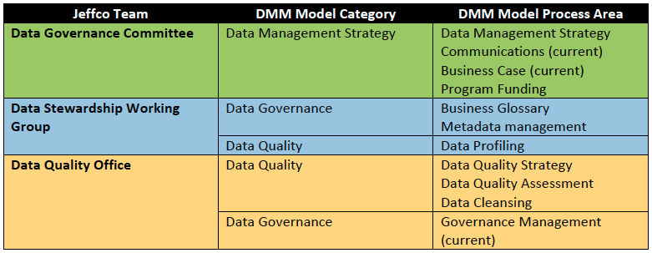
Current Jeffco Operating Model Mappings to the DMM Model

Slide 83
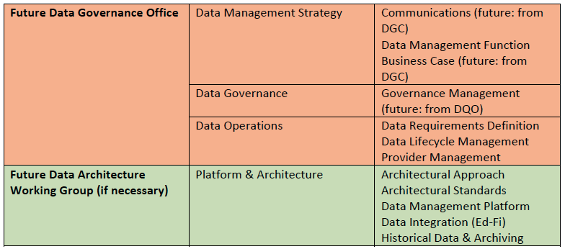
Future Desired State Jeffco Operating Model Mappings to the DMM Model

Slide 84
DMM Model Capability Levels
Level | Title | Description
Level 5 | Optimized | Process performance is continuously improved driving business growth. Data is viewed as critical to survival in a dynamic and competitive market.
Level 4 | Measured | Process metrics have been established, are measured, and formal processes for managing variances exist. Data becomes a source of competitive advantage.
Level 3 | Defined | Sets of standard processes have been developed and refined providing consistency of execution. Data is treated as critical for successful mission execution.
Level 2 | Managed | Processes are planned and executed according to policy, generally across the enterprise. There is awareness of the need to manage data as a critical asset.
Level 1 | Performed | Processes are performed ad-hoc at a project or application level with little regard to the broader organization. Data is thusly managed much in the same manner.
Notes:
Jeffco added a Level 0 defined at a high level as not yet meeting the DMM capability Level 1, but an awareness exists of the need to better manage data within our environment. We can think of Level 0 as being “foundational”. The beginnings of improving data management process capabilities are present.
There is a link to a capability levels matrix mapped against the current and desired Jeffco data management combinations (20), but requires permission.

Slide 85
Information Management

Slide 86
Data Governance vs. Information Management
Information Management:
“The execution of a set of principles and processes to derive maximum value from an organization’s information, while protecting it as a key corporate asset”
Bradley, Christopher. (2013) Implementing Effective Data Governance

Slide 87
Key Information Management Dimensions

Slide 88
Process Management

Slide 89
Data Governance and Process Management
The disciplines of process management support data governance, and vice-versa.
Process Stewards need data as input to their processes. Data stewards help them to have access to this data.
Process Stewards are often Data Stewards for the data that their processes create.
CELT, Data Governance and Management Presentation, 2013

Slide 90
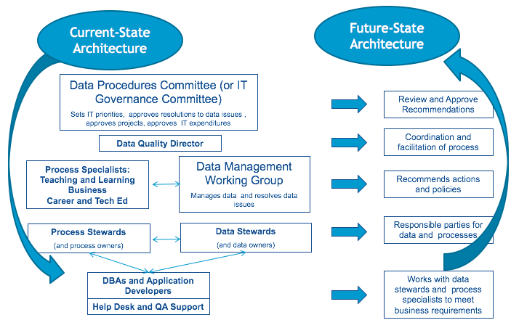
Data Governance and Process Management Structure

Slide 91
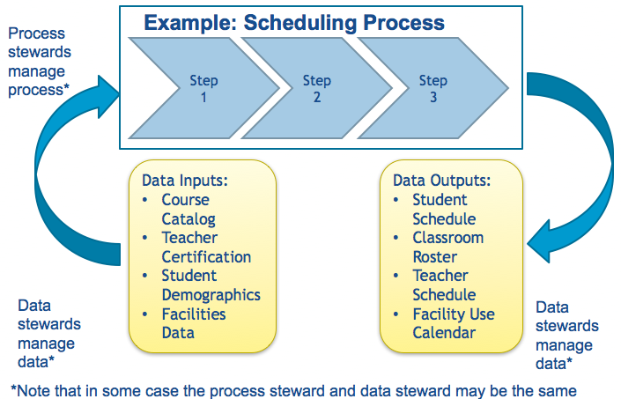
Relationship of Data Stewards and Process Stewards
CELT, Data Governance and Management Presentation, 2013

Slide 92
The Importance of Process Management
All work within the district can be defined in terms of processes.
District operations and organizational efficiency and effectiveness are best managed, monitored and improved by using the disciplined approach of process management.
Process management can be used to bridge silos and foster collaboration within the district, especially where similar processes are used. An example of this is the commonality between Response to Intervention, Individual Education Plans, and personalized instruction – all of which can use similar processes, tools and data structures to personalize instruction.
Processes, once defined, can be measured, monitored and improved.
Process measures, such as cycle time, per unit cost and customer satisfaction, can be applied to almost all processes, and as such can provide a rich set of data for benchmarking and continuous improvement.
Documenting processes is a best practice approach to collecting, sharing (especially with new employees) and retaining important institution knowledge.

Slide 93
Enterprise Architecture

Slide 94
Data Governance relationship to Education Enterprise Architecture
Education Enterprise Architecture (EEA) relies on both governance and management structures are critical for long-term sustainability.
Architecture governance identifies the key roles, manages the architecture processes (such as creating current and future states of the enterprise, reviewing upcoming procurements and so on) and architecture content (such as requirements, standards, visuals of current and future states, and so on).
Data governance defines how the agency makes decisions about its information assets by establishing policies, standards, processes and ownership.
Process management establishes, documents and assigns ownership for the agency’s key processes, which is a core component of developing the business architecture. Process management also has a continuous improvement focus, which helps create a future state.
Project management creates an agency-wide project management office and a process for approving and tracking the progress of high-priority projects. This part of governance ensures the agency consistently plans and implements the projects necessary to achieve the future state.
Reform Support Network (2014) Education Enterprise Architecture: Aligning Education Reform with Services and Systems.

Slide 95
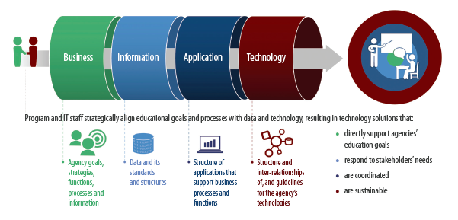
The Role of Data Governance in EEA
Data Governance
Reform Support Network (2014) Education Enterprise Architecture: Aligning Education Reform with Services and Systems.

Slide 96
Data Governance as an Element of EEA Governance
EEA uses data stewards to further refine the Business Architecture and serve as subject matter experts in the development of designs, specifications and business rules for data structures, data access and security and integration strategies.
Organizations will benefit from establishing a data governance structure and integrating it with EEA governance. The U.S. Department of Education’s
Statewide Longitudinal Data Systems (SLDS) Program provides useful materials on an effective data governance process.
Many education agencies have taken steps to configure their information assets by implementing data governance and data standards and assigning
greater responsibility for managing information to data stewards in the program and business areas. Data governance structures may identify key strategic decisions, core agency processes and process owners, policy requirements and organizational and capacity issues and initiate the architecture.
Reform Support Network (2014) Education Enterprise Guidebook

Slide 97
Data Consumer Concerns
Useful for consideration when developing an assessment framework

Slide 98
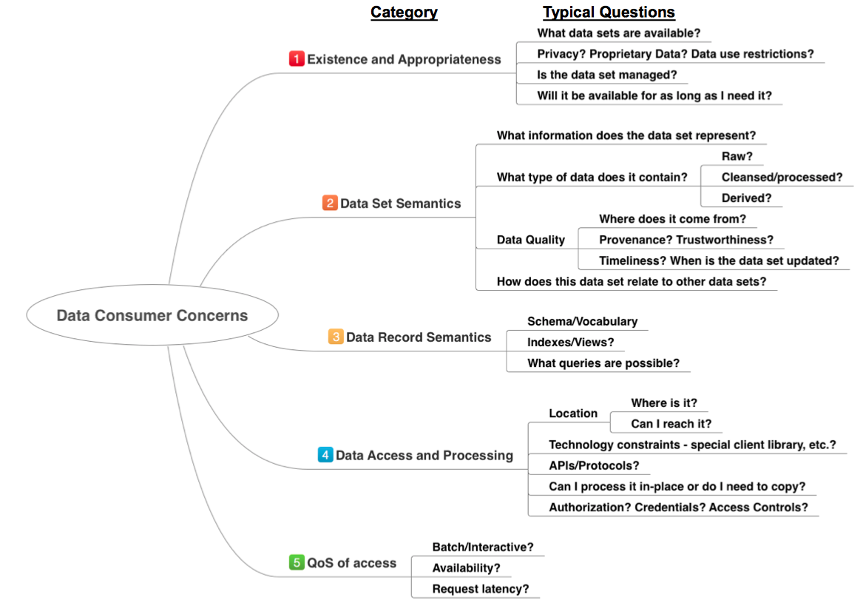
Klein, John. (2017) 6 Things You Need to Know About Data Governance. Pittsburgh, PA: Software Engineering Institute, Carnegie Mellon University

Slide 99
References
Bill & Melinda Gates Foundation (2015) Data Systems Working Group Guide to Management Practices available at https://drive.google.com/drive/u/0/folders/0Bx2BBMkIR-83SEd4MGxMbUo4Nkk
Bradley, Christopher. (2013) Implementing Effective Data Governance available at https://www.slideshare.net/inforacer/impdata-gover
CELT (2013) Data Governance and Management. Marlborough, MA
CELT (2009) Data Governance Process. Marlborough, MA
CELT (2013) OCPS Data Governance Executive Briefing. Marlborough, MA
The Center for IDEA Early Childhood Data Systems (2016) Who’s in Charge? – Improving How You Manage and Govern Your Data System, Presentation at 2016 Improving Data, Improving Outcomes Conference, New Orleans, LA available at http://bit.ly/2pXnJps
CoSN (2014) 10 Principles to Guide the User and Protection of Student Data, website available at http://studentdataprinciples.org
Data Quality Campaign (2017) From Hammer to Flashlight - A Decade of Data in Education, available at https://dataqualitycampaign.org/resource/from-hammer-to-flashlight-a-decade-of-data-in-education/

Slide 100
References
Federal Trade Commission (2015) Start with Security: A Guide for Business; available at https://www.ftc.gov/tips-advice/business-center/guidance/start-security-guide-business
Gidley, Scott., Rausch, Nancy. (date) Best Practices in Enterprise Data Governance. Carey, NC: SAS Institute available at https://www.sas.com/en_us/whitepapers/best-practices-enterprise-data-governance-106538.html
Harper, Jelani. (2015) Distinguishing Data Management from Data Governance. DataVersity Blog available at http://www.dataversity.net/distinguishing-data-management-from-data-governance/
iNACOL (2016) Student-Centered Learning: Functional Requirements for Integrated Systems to Optimize Learning available at: http://www.inacol.org/resource/exploring-integrated-learning-systems-to-optimize-student-centered-learning/
Infosys. (2015) Perspective: Effective Data Governance. Bangalore, India available at https://www.infosys.com/data-analytics/insights/Documents/effective-data-governance.pdf
JeffCo Public Schools. (2016) Data Governance Operating Model. (draft v0 10). Jefferson County, Colorado: Author
Klein, John. (2017) 6 Things You Need to Know About Data Governance. Pittsburgh, PA: Software Engineering Institute, Carnegie Mellon University available at http://resources.sei.cmu.edu/library/asset-view.cfm?assetid=495718

Slide 101
References
Levy, Evan. (2016) The 5 Essential Components of a Data Strategy. Carey, NC: SAS Institute available at https://www.sas.com/content/dam/SAS/en_us/doc/whitepaper1/5-essential-components-of-data-strategy-108109.pdf
MDM Institute (date) Enabling the Agile Enterprise: Driving Digital Transformation via Data Governance, Burlingame, CA available at http://www.oracle.com/us/products/applications/finance-visual-whitepaper-2554863.pdf
National Institute of Standards and Technology (2010) Guide to Protecting the Confidentiality of Personally Identifiable Information (PII), (NIST Special Publication 800-122) available at http://nvlpubs.nist.gov/nistpubs/Legacy/SP/nistspecialpublication800-122.pdf
Office of Superintendent of Public Instruction, State of Washington (2015) Data Governance System for K-12 Data, Policies and Procedures available at http://www.k12.wa.us/K12DataGovernance/pubdocs/DataGovernanceManual.pdf.
Privacy Technical Assistance Center (2014): Data Governance and Stewardship, available at http://ptac.ed.gov/sites/default/files/Data_Governance_and_Stewardship.pdf.
Privacy Technical Assistance Center (2015): Data Governance Checklist, available at http://ptac.ed.gov/sites/default/files/Data%20Governance%20Checklist%20%281%29.pdf.

Slide 102
References
Privacy Technical Assistance Center (2011): Data Security: Top Threats to Data Protection, available at http://ptac.ed.gov/sites/default/files/issue-brief-threats-to-your-data.pdf.
Protiviti (2014) Data Governance Overiew, ISACA Atlanta available at https://www.isaca.org/chapters3/Atlanta/AboutOurChapter/Documents/GW2014/Implementing%20a%20Data%20Governance%20Program%20-%20Chalker%202014.pdf
Reform Support Network (2014) Education Enterprise Architecture: Aligning Education Reform with Services and Systems.
Reform Support Network (2014) Education Enterprise Guidebook.
SAS Institute (2015) Data Management Backgrounder – What it is and why it matters, available at https://www.sas.com/content/dam/SAS/en_us/doc/other1/data-management-backgrounder-107751.pdf.
Siegel, Bob (2016) What is the difference between privacy and security? IDG CIO Opinion Article available at http://www.cio.com/article/3075023/privacy/the-difference-between-privacy-and-security.html

Slide 103
References
Stiglich, Pete (2012) Data Governance vs. Data Management. Healthcare Blog available at http://blogs.perficient.com/healthcare/blog/2012/06/12/data-governance-vs-data-management/
Sun, Helen. (2011) Enterprise Information Management: Best Practices in Data Governance. Redwood Shores, CA: Oracle Corporation available at https://iapp.org/media/pdf/knowledge_center/oea-best-practices-data-gov-400760.pdf
Young, Rawdon. (2012) Data Management Maturity (DMM) Model Update. Pittsburgh, PA, Software Engineering Institute, Carnegie Mellon University available at http://cmmiinstitute.com/data-management-maturity

